Slide 1

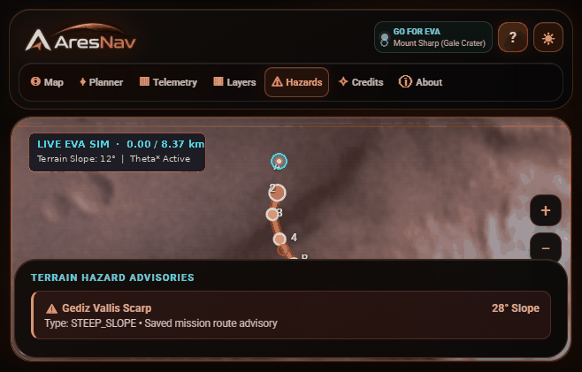
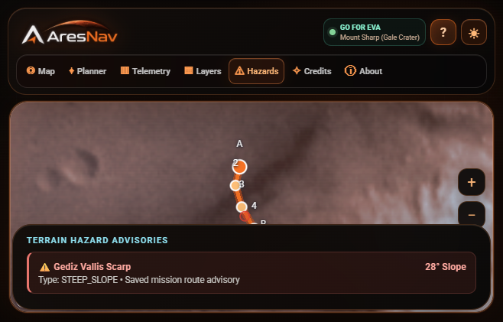
REAL ARESNAV SCREEN · HAZARD VIEW
NASA INTERNATIONAL SPACE APPS CHALLENGE · 2026
Mars surface
navigation, made visible.
A 3D workspace to explore EVA routes, terrain context, hazards, and mission estimates.
BUILT BY TEAM NEUROMARS
Rohit Solanki · Gourav Jangid
Explore a saved route; inspect the mapped scarp advisory.
DEMO PROTOTYPE / MOUNT SHARP + JEZERO CRATER
A practical Mars surface-planning demonstrator
01

Slide 2
THE CHALLENGE
A route is more than a line on a map.
Surface planners need terrain, science context, and mission estimates in one view.
01
02
03
Terrain changes
Evidence is spread out
Plans need context
Slopes, rough relief, incomplete elevation samples, and local advisories can change how a route should be reviewed.
Elevation, thermal context, geology, place names, and rover records come from different map layers and services.
A useful demo should make endpoints, waypoints, resource estimates, data sources, and uncertainty easy to inspect.
ARESNAV RESPONSE
Bring a Mars map, route setup, optional terrain analysis, and readable mission context together.
ARES NAV / NEUROMARS
02

Slide 3
THE PRODUCT
One workspace for a Mars surface scenario.
Switch between the globe, route planner, telemetry, hazards, and science layers.
APPLICATION SCREENSHOT · HAZARD ADVISORIES
3D map
Navigate Mars with a Cesium globe and a Viking MDIM 2.1 basemap.
Route planner
Choose Gale or Jezero, endpoints, and Suit Walk / Rover / Scout mode.
Science context
Toggle MOLA terrain, TES thermal inertia, geology, hazards, and mission records.
Field guide
A 15-step, hands-on tour helps a first-time user find the main controls.
The map can show historic rover records; these are not live rover positions.
ARES NAV / NEUROMARS
03

Slide 4
UNDER THE HOOD
How experimental terrain routing works.
A transparent pipeline turns selected endpoints and sampled map context into a reviewable candidate route.
01
02
03
04
05
Request
Sample
Score
Search
Explain
Start, destination, grid spacing, and site hazards.
NASA Mars Trek MOLA/HRSC elevation on a bounded grid.
Slope, relief, mapped geology, hazards, and coarse TES color transitions.
Theta* checks any-angle paths; unknown and restricted cells are blocked.
Return route metrics, modeled review flags, confidence notes, and an offline text brief.
RESOLUTION & SAFETY BOUNDARY
The planning grid is capped at 55 × 55 cells. MOLA/HRSC is roughly 200 m native spacing near the equator (varies by latitude); finer grid choices do not create finer source data.
This is low-confidence planning support only: sampled crater screening can miss hazards, and the result is not operational or astronaut-certified guidance.
ARES NAV / NEUROMARS
04

Slide 5
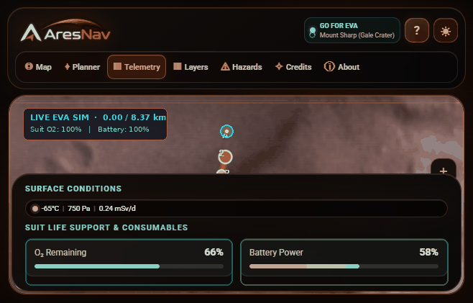
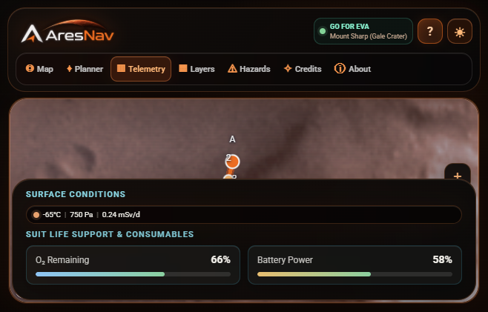
WHAT THE USER SEES
Mission context, not a black-box answer.
The console pairs a route summary with environmental sample values and modeled resource estimates.
APPLICATION SCREENSHOT · TELEMETRY VIEW
MOUNT SHARP DEMO SCENARIO
8.37 km
5.3 hrs
saved route distance
estimated route duration
66%
58%
modeled O₂ remaining
modeled battery remaining
Sample conditions
−65 °C · 750 Pa · 0.24 mSv/day
All values shown are local demonstration data or modeled estimates—not live suit sensors, forecasts, or mission limits.
ARES NAV / NEUROMARS
05

Slide 6
DATA & SCIENTIFIC HONESTY
Show the source. State the limits.
AresNav combines public planetary data with clearly labeled local demo mission values.
MAP & SCIENCE CONTEXT
WHAT IT CANNOT PROMISE
NASA/JPL Mars Trek
No astronaut-scale sensing
Viking MDIM 2.1 imagery; optional terrain, elevation, thermal, and named-place layers.
Orbital elevation cannot resolve small rocks, cracks, dust, or changing surface conditions.
Planetary science layers
Sampling can miss hazards
MOLA/HRSC elevation, MGS TES thermal context, and USGS regional geology.
Grid spacing limits detail; crater-like depression checks are heuristic, not a guarantee.
Mission records
Not operational guidance
Curiosity and Perseverance traverse records and site features are historical map data.
The terrain route is experimental and low confidence; expert review and validated systems remain essential.
Sources are credited in the app; providers do not endorse this project.
Live imagery and several map services require an internet connection.
ARES NAV / NEUROMARS
06

Slide 7
NEXT STEPS
A prototype that is ready to be challenged.
Our next work is validation, better provenance, and clearer uncertainty—not claims of flight readiness.
01 / VALIDATE
02 / CLARIFY
03 / EXTEND
Compare candidate routes against documented rover traverses and expert review.
Make data age, map resolution, and route confidence even more visible.
Improve offline briefs and add side-by-side route comparison for demos.
Thank you.
PROJECT REPOSITORY
Questions?
github.com/rohitsolanki07-sys/Mars_project
Team NeuroMars · Rohit Solanki · Gourav Jangid
ARES NAV / NEUROMARS
07

